Slide 1
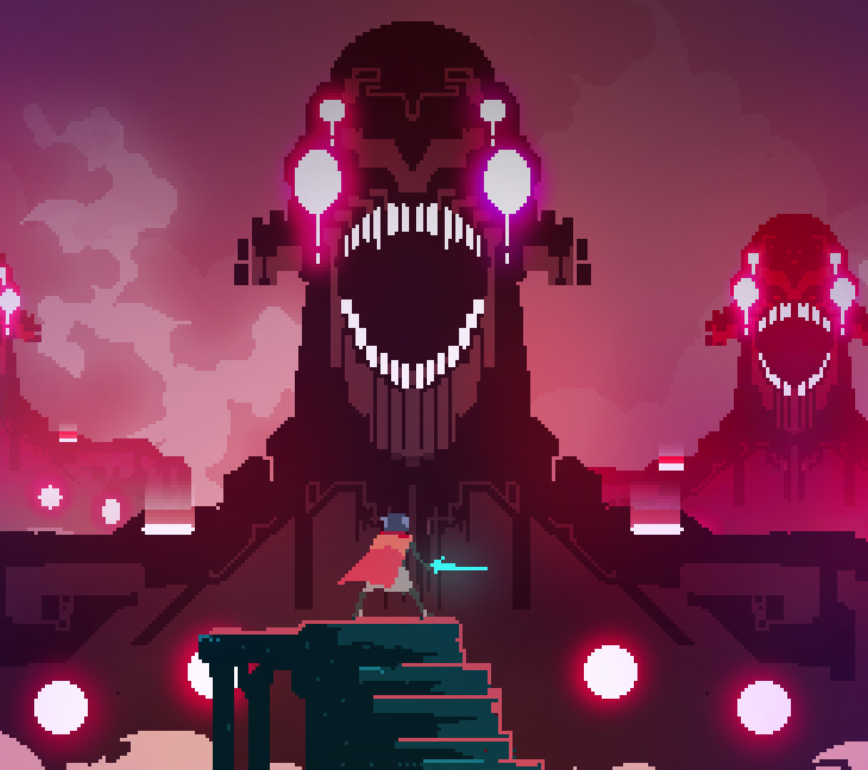
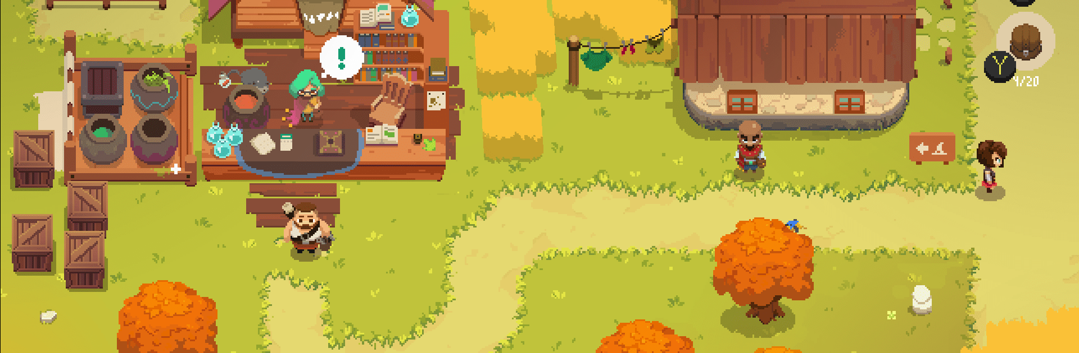

Indie Game Developer Hub
Anfer Molina

Slide 2
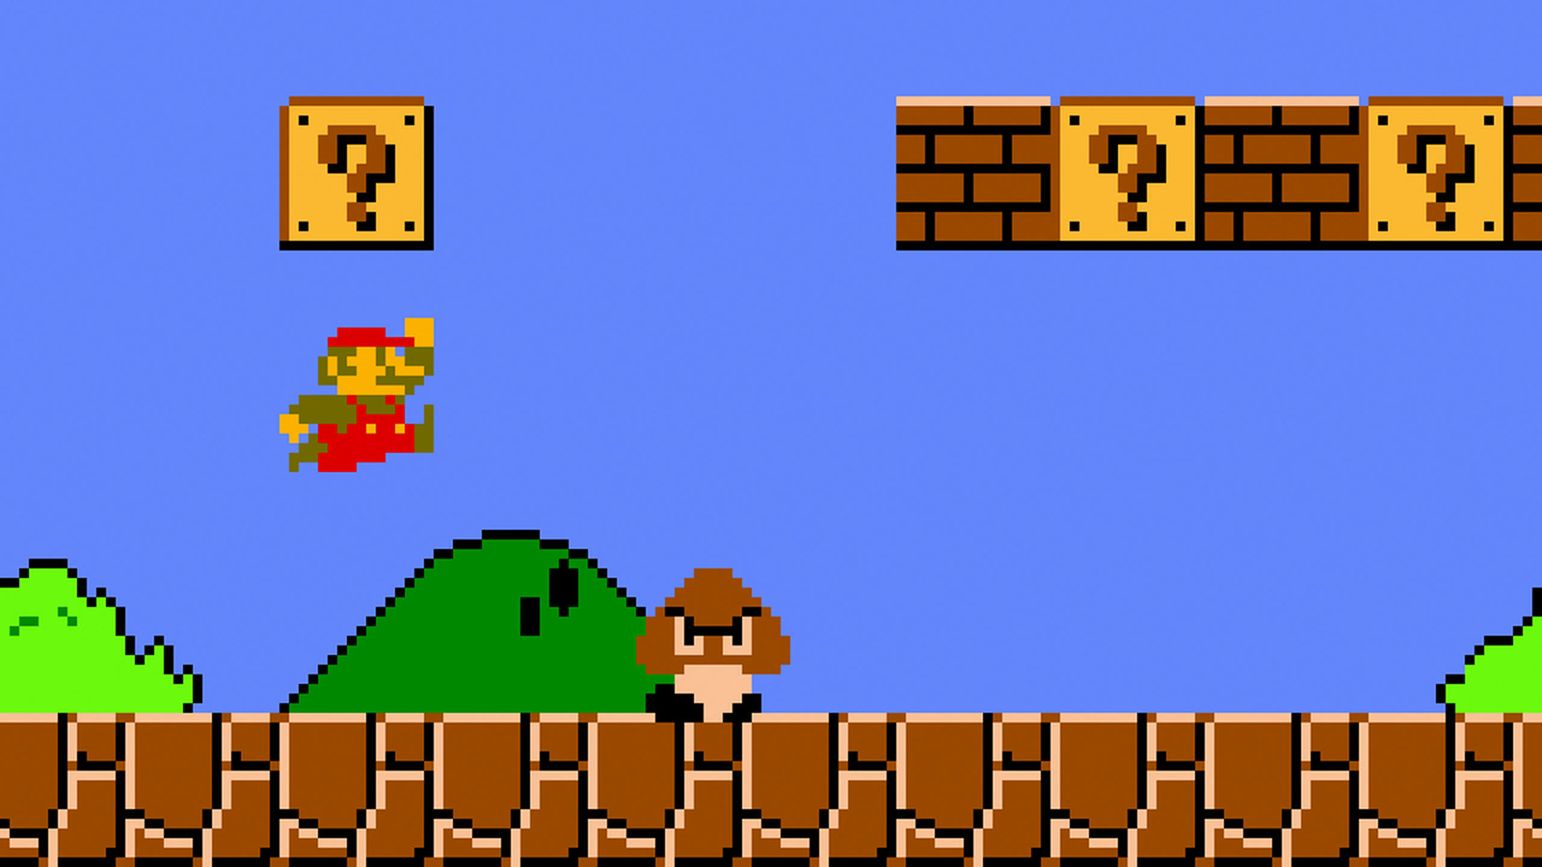
To create a new game, we must first understand and appreciate the players who will enjoy it.
Shigeru Miyamoto

Slide 3
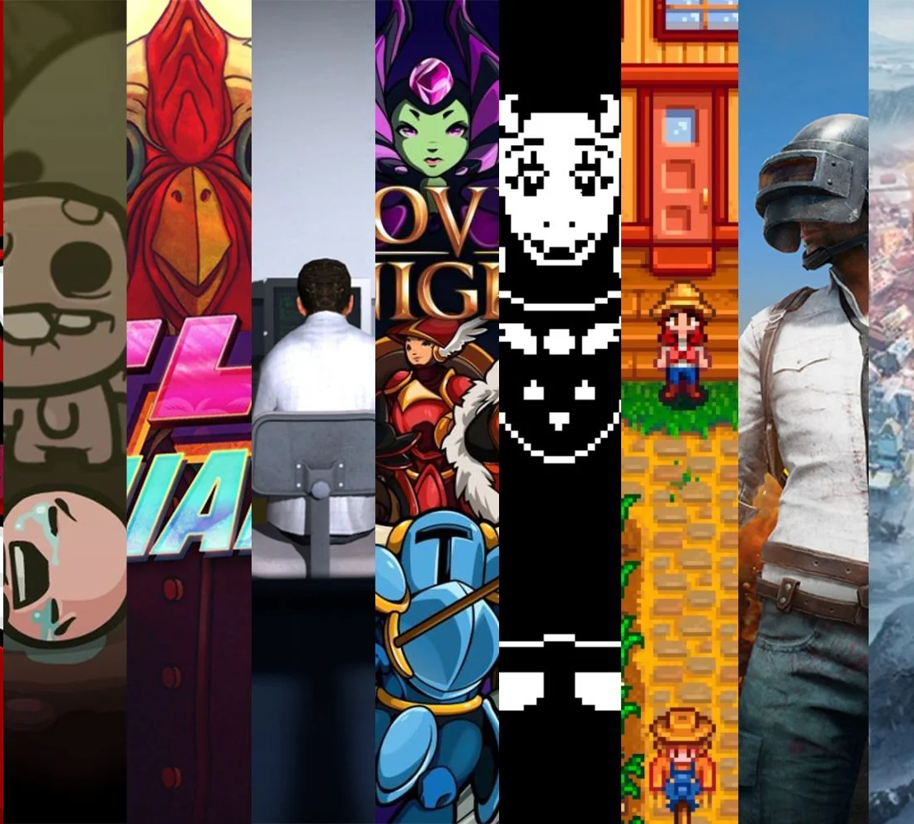
Introduction
+ Our platform is designed to connect indie game developers, providing tools for project management*, collaboration, and networking
+ Tailored for individual developers, small indie teams, indie studios or just enthusiasts looking for a collaborative and supportive development environment.

Slide 4
Business Rules
Developers can only contribute to no more than three active projects at any given time.
If the project's Estimated Completion Date is 90 days past the current date, the project's status must change automatically from active to inactive.

Slide 5
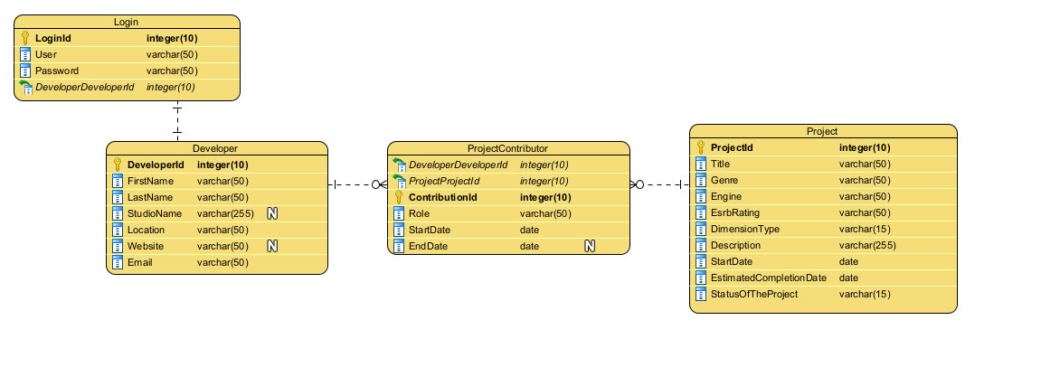
ERD

Slide 6

Let’s check the demo!

Slide 7
Future Updates
Comprehensive Login and registration form.
Email notifications.
Project Management capabilities.
Game hackathon hub.

Slide 8

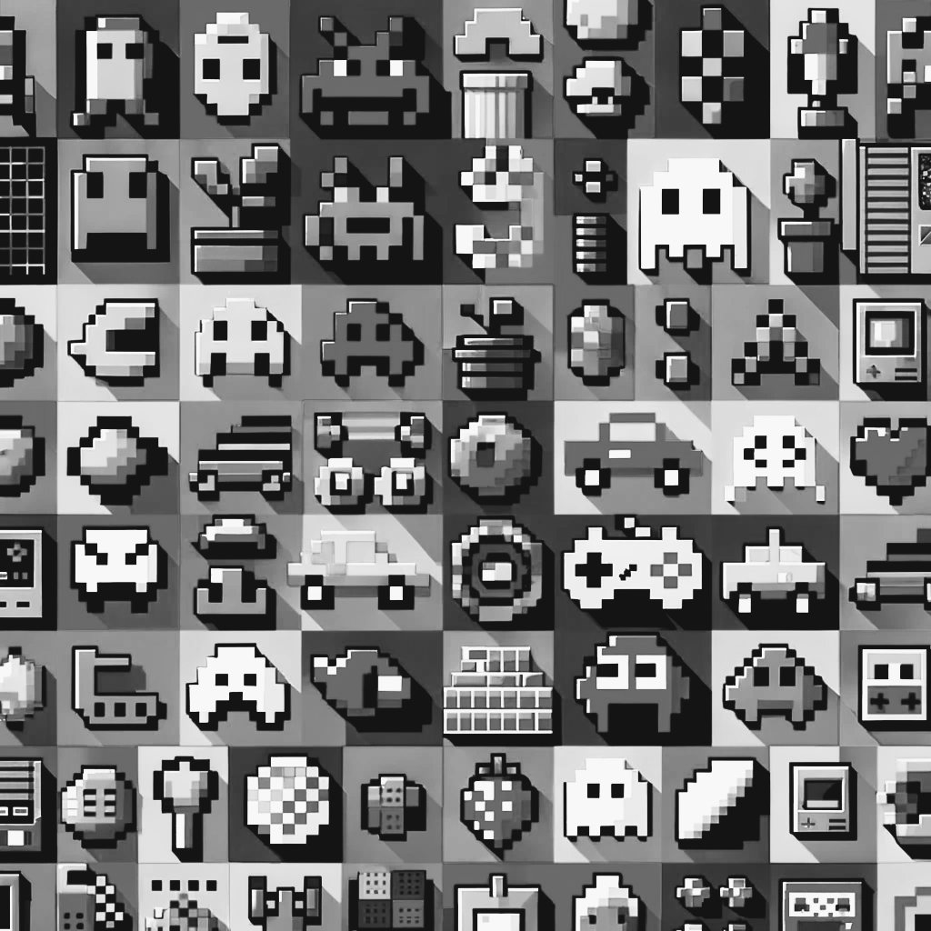


Thank you
Presenter Anfer Molina
Email hi@anfermolina.com
anfermolina.com

